Slide 1

Deliver 2
Image Segmentation
Team 12
Sergio Sancho & Axel Barroso
M2: Optimisation and Inference for Computer Vision
Masters in Computer Vision
Universitat Autònoma
de Barcelona

Slide 2
Summary
Mandatory tasks
Part I: Implement the Chan-vese algorithm and test it
Part II: Video showing the curve evolution
Part III: Discover under which assumptions Chan-Vese works Optional task
Part I: Test with our own images

Slide 3
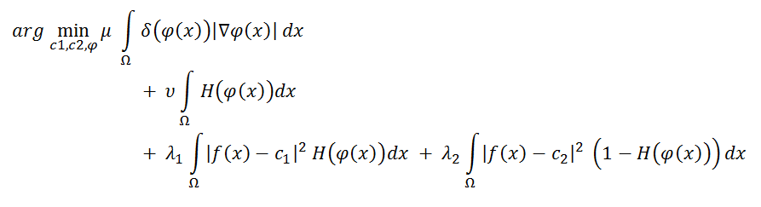
Mandatory tasks
Part I: Implement the Chan-vese algorithm and test it
In this deliver, we were asked to perform segmentation among different binary images according to level sets theory. We implemented an explicit version of Chan-Vese algorithm in order to detect contours. We present the problem as the minimization of the following energy functional:

Slide 4
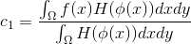
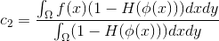
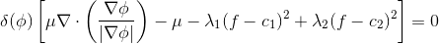
Mandatory tasks
Part I: Implement the Chan-vese algorithm and test it
We need tools to deal with this functional. We use the Euler-Lagrange formulation, and we end up with:
C1 and C2 variables are the mean value of the gray-level in the different regions. We initialized the region averages to 1 and -1 for the first iteration.
We base our numerical implementation on the semi-implicit scheme described in Gertreuer, but applied it explicitly. This consist in one Gauss-Seidel sweep from left to right, top to bottom:

Slide 5
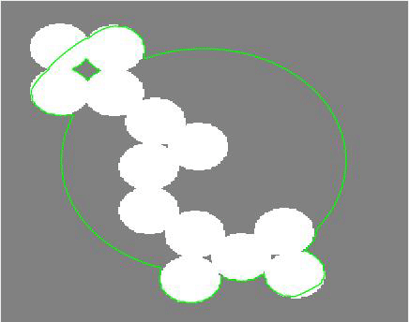
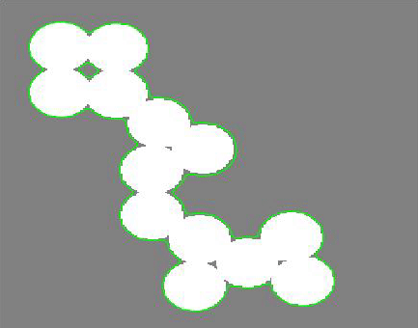
Mandatory tasks
Part II: Video showing the curve evolution (I)
CIRCLES
Parameters:
mu = 1.0
dt = 1.0
eta = 1.0
reIni = 500
Iterations = 952
We saw using this example different evolution curves depending on mu parameter. This image was really revealing due to its easy segmentation. That is why, using different mu parameters we were able to understand properly the evolution curve. As we know, mu penalize the length of the curve, using low values, we see a higher adaption to the figure. We selected mu 1, that for our case was enough, and it allows us a faster convergence.

Slide 6
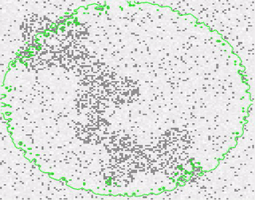
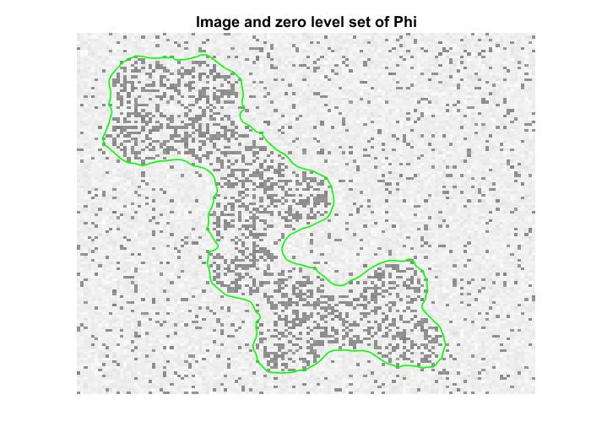
Mandatory tasks
Part II: Video showing the curve evolution (I)
NOISED CIRCLES
Parameters:
mu = 0.4
dt = 0.5
eta = 1.0
reIni = 500
Iterations = 2230
This image is composed by noise and an object depicted in the center by a cloud of pixels. Either the object and the noise are represented by pixels with different intensities. Thus, there are more density of pixels with a low intensity inside the object. This means that the region of the object has a lower mean of pixel intensity than the rest of the image. This fact will help the algorithm to converge. In this case, a mu of 0.4 allowed to solve the segmentation problem with 2230 iterations.

Slide 7
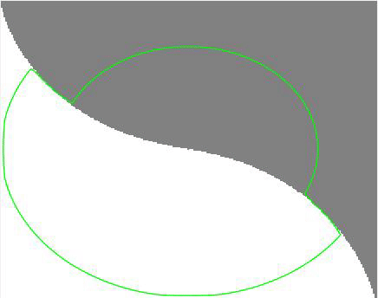

Mandatory tasks
Part II: Video showing the curve evolution (II)
PHANTOM17
Parameters:
mu = 0.8
dt = 1.0
eta = 1.0
reIni = 500
Iterations = 1200
We saw using this image different evolution curves depending parameters and initial phi functions. The image was easy to segment. It has no noise, and two segments well-defined. Although, we found a tough problem in this image. The correct segmentation comes after a few iterations, but its convergence takes too much longer. Each time we initialize the phi function, the difference between iteration grows a lot. The following iterations reduces until almost 0 the difference between iterations value, but again, once the initialization is performed, the error goes high. It takes a long time to adjust the tolerance value in this case despite of the faster segmentation.

Slide 8
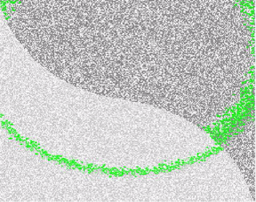
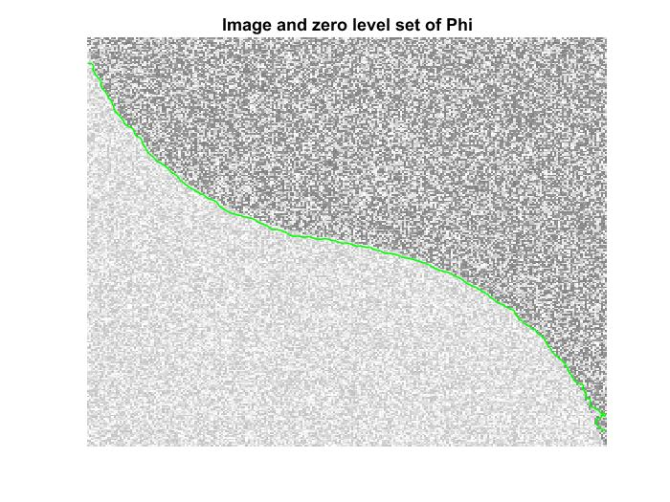
Mandatory tasks
Part II: Video showing the curve evolution (II)
PHANTOM18
Parameters:
mu = 0.4
dt = 0.5
eta = 1.0
reIni = 500
Iterations = 350
This image is the noised version of PHANTOM17. Despite the noise, this image still appear to be easy to segment because the average intensity values of the two regions are different. We initialized phi with the recommended values for this problem*. This, and using a big learning rate allowed us to solve it in 350 iterations.
(*) phi_0=(-sqrt( ( X-round(ni/2)).^2 + (Y-round(nj/4)).^2)+50)

Slide 9
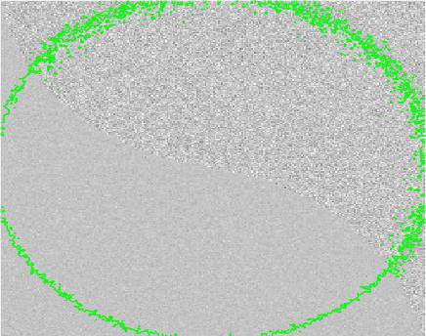
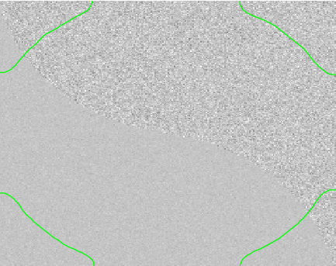
Mandatory tasks
Part II: Video showing the curve evolution (III)
PHANTOM19
Parameters:
mu = 0.2
dt = 1.0
eta = 1.0
reIni = 500
Iterations = 25000
We can see that segmentation does not work in this example. We used different parameters and different phi functions. The algorithm is able to converge quite faster. It does not mean that the segmentation is correct though. We used a really low tolerance because we wanted to discover the behaviour in higher iterations.
We will come back to this example in the slide number 11.

Slide 10
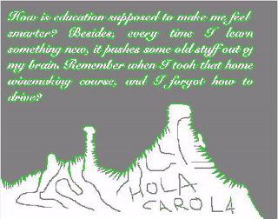
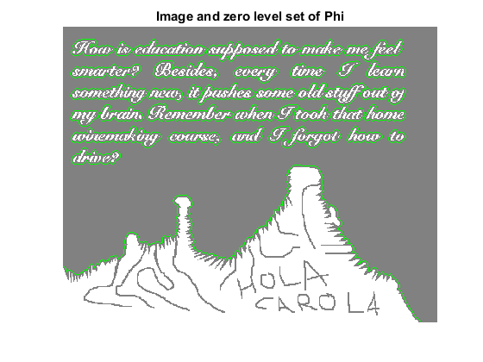
Mandatory tasks
Part II: Video showing the curve evolution (III)
HOLA CAROLA
Parameters:
mu = 1.0
dt = 0.5
eta = 1.0
reIni = 500
Iterations = 40
This image is quite easy to segment, the convergence comes after a few iteration. As we see, the regions are well-defined. That is basically because it is a mask, it has no noise. We used Chan-Vese algorithm to obtain a smoother mask. This makes us easier the following inpainting process. We used mu of 1 that penalizes the length of the curve, that is why we obtained a smoother mask for all regions. Using smaller mu, we would obtain a more accurate segmentation. On the other hand, using a higher mu, we would obtain a really flat area. We could even lose letter segmentation. We also can play with the tolerance to obtain a similar result.

Slide 11
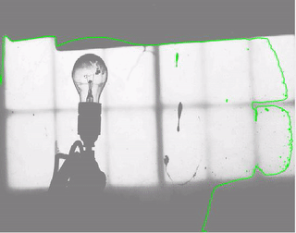
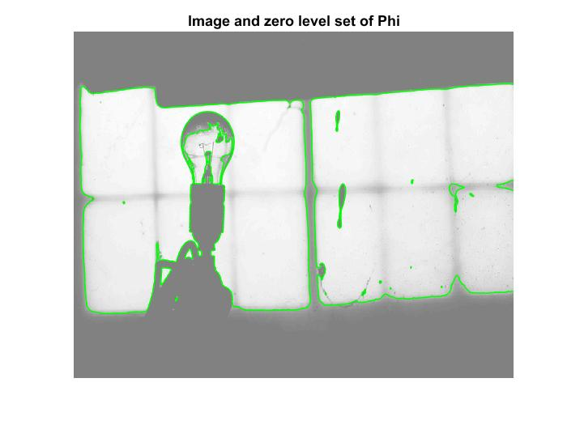
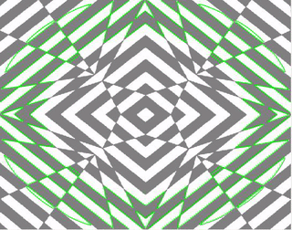
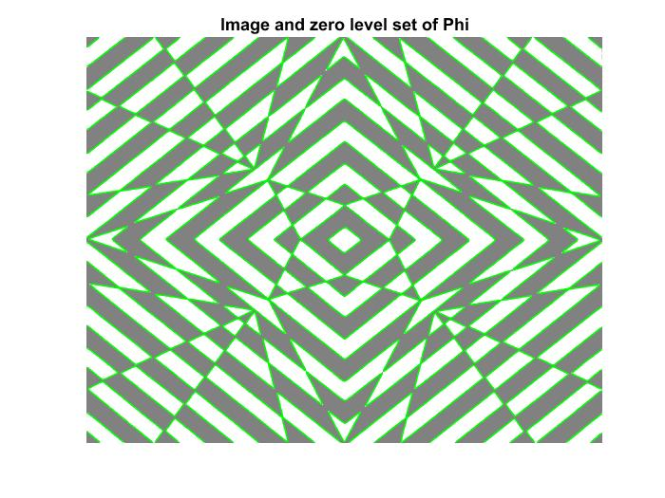
Optional task
Part I: Test with our own images
OPTIONAL 1
Parameters:
mu = 0.1
dt = 0.8
eta = 1.0
reIni = 500
Iterations = 60
OPTIONAL 2
Parameters:
mu = 0.4
dt = 0.5
eta = 1.0
reIni = 500
Iterations = 50

